Slide 1
Housekeeping
Describing data and basic stats. (Chapter 3)
Describing one variable.
Describing two variables.
Stats-y plots to explore each.
Assignment Q+A – ask whatever. Specifically, make sure that you can do what you want with the data. It is normal to have to adjust either your plan or the datasets once started.
You really want to start planning! It is different doing it solo.
If you guys don’t have questions or want to ask complex stuff…
Tableau features:
Bins, details, parameters, and some calculations.
Dynamic axes with parameters – applied to stat’s heavy data.
Make an interactive dashboard to explore statistical descriptions!
07… data file from Brightspace (there’s some code there that we’ll copy/paste too).

Slide 2
Summary Measures

Slide 3
Populations and Samples
The first description of data is the idea of a POPULATION and a SAMPLE.
Population = all the data.
Sample = some subset of data that we use to analyze.
Population is all the data for our scope, not always every person alive.
In general, we take a sample of data, analyze it, and extrapolate to the population.
E.g. a political poll surveys ~1k people, and projects for the entire populace.
In reality, we often can’t get data for an entire population.
We want samples that are large and match the population as a whole.
Both of these things mean that our analysis will project for the entire population.

Slide 4
Samples
Conclusions we can draw from our analysis are better if a sample is:
More representative of the population.
Larger.
As well, samples will allow us to predict for a population better when the value is less variable.
If the value we are looking at is more constant, we need less data to project it.

Slide 5
Describing one Variable
First, we can look at describing one value at a time.

Slide 6
Measures of Location
One key thing to understand about data is where it is located, or centered.
One of two things needed to define a normal distribution.
We have 3 main measures for location, the averages:
MEAN – The “average”, values added and divided by count.
MEDIAN – Value in the middle. (50% above, 50% below)
MODE – Most frequent value.
Depending on scenario, any of which may be useful.
E.g. When looking at income, the median is less impacted by really rich people.
In a true normal distribution, all these measures are equal.

Slide 7
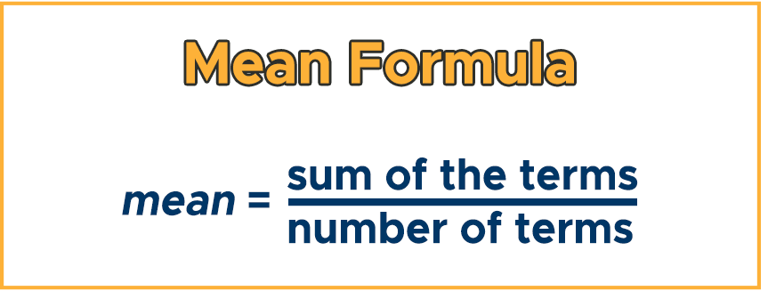
Mean
MEAN is what we normally think of as the average.
Sum of values, divided by count of values.
Can be very impacted by outliers (very high/low values).

Slide 8
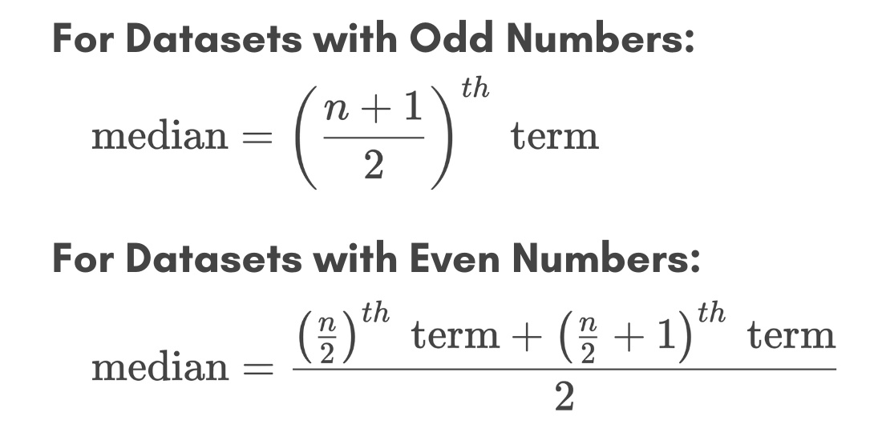
Median
The median is the value “in the middle” – half of values are above, half below.
The median is more resistant to outliers (more on this later).
Commonly used when we have data like income – with large values that would impact the mean drastically.

Slide 9
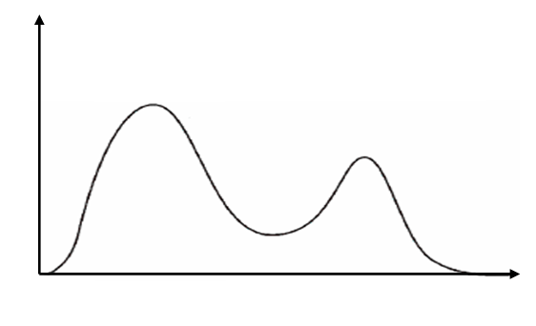
Mode
MODE is the most frequently occurring value.
Most useful if data is discreet – can only take on certain values.
Pops up with distributions in terms such as BIMODAL, distributions that have 2 peeks.
Note – with continuous data, the mode might not have much meaning. E.g. with grades that are to 2 decimal places (59.23%, 81.04%, etc…) even if the values are tightly clustered, we won’t see the exact same value repeated often.

Slide 10
Locations in tableau
Mean, median, and mode functions.
Reference lines.
Note: for many/most “real life” population wide values, we often want to use the median as the “average”. Think of something like income, the oligarchs of the world drag up the mean substantially. The median is a more meaningful measure for most cases.

Slide 11
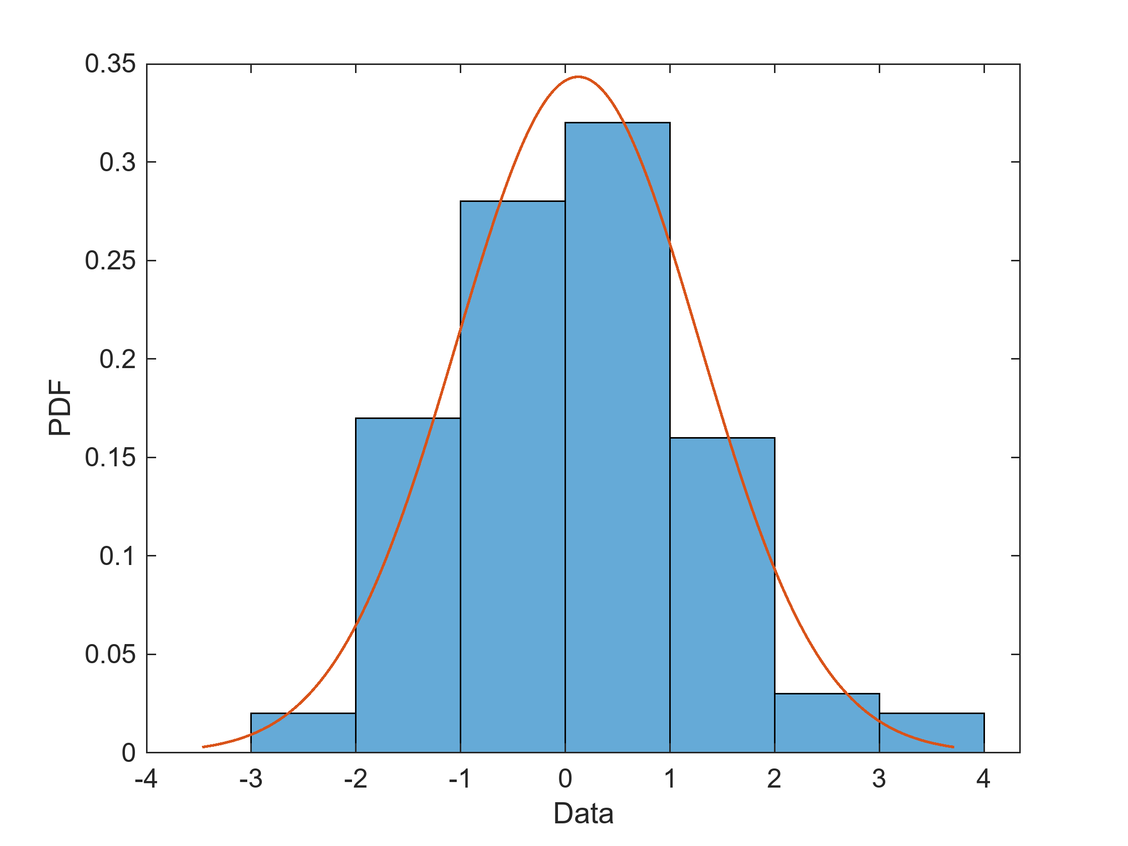
Distributions
The distribution of data describes its “shape”.
Data is distributed over the RANGE – the minimum to the maximum value.
Range tells us the limits, distribution describes the pattern
Knowing the distribution can help us know how to treat our data.
When generalizing from samples, we “lean on” what we know about a distribution to help the extrapolation.

Slide 12
Normal Distribution
The NORMAL DISTRIBUTION is perhaps the most common distribution.
Also known as a bell curve.
A large percentage of data will follow a normal, or normal-ish, distribution.
E.g. sizes of animals, people’s height, etc…
The normal distribution has a bunch of properties and tools that are premade/pre-calculated for any data that is normal.
Analyzing normal data is often easier.
We can TRANSFORM data to make it normal, for easier analysis.
Lots of data follows a normal distribution, but we can’t just assume it all does.

Slide 13
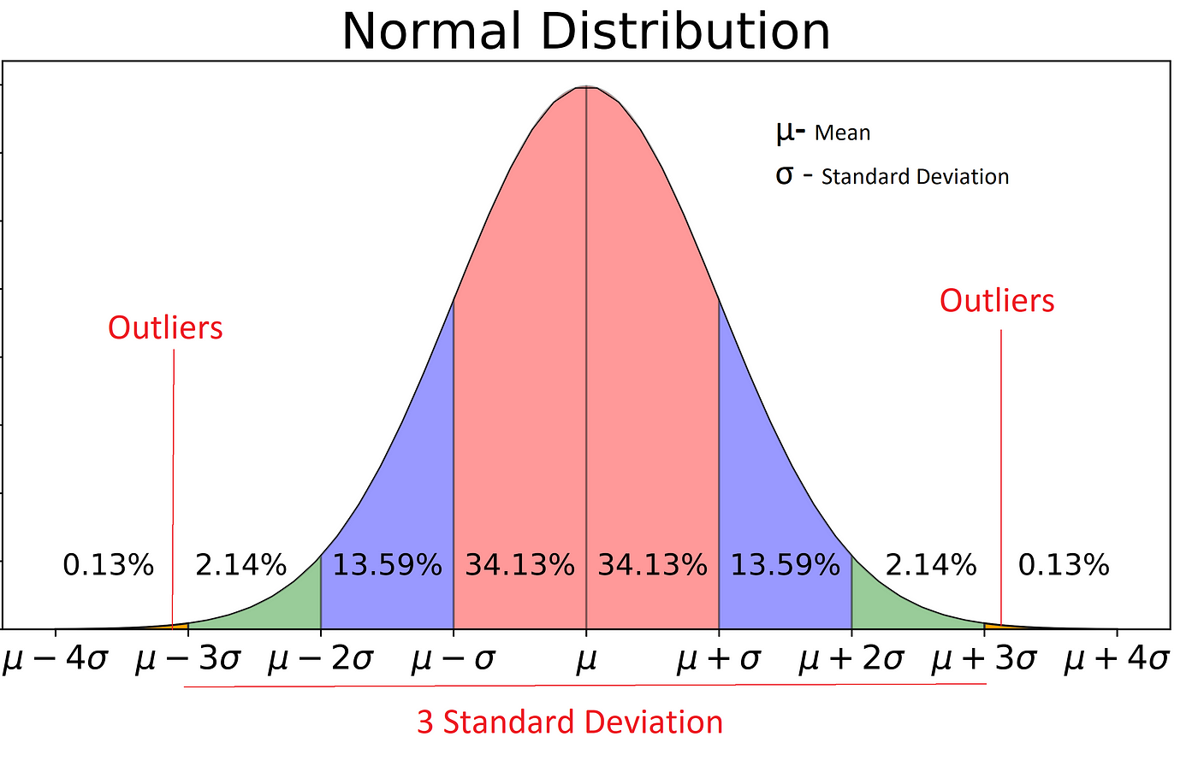

Slide 14
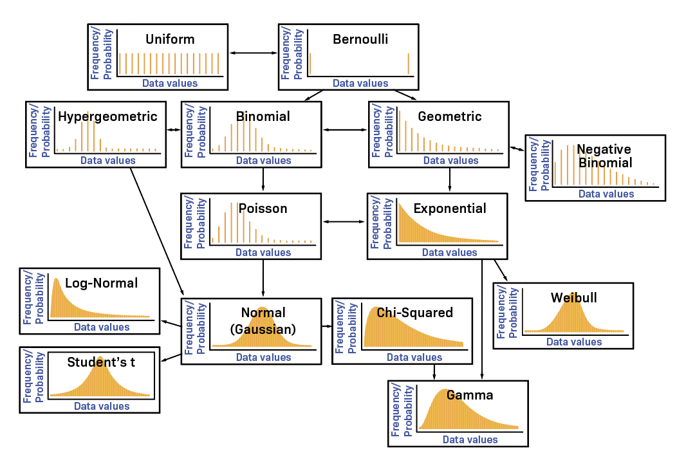

Slide 15
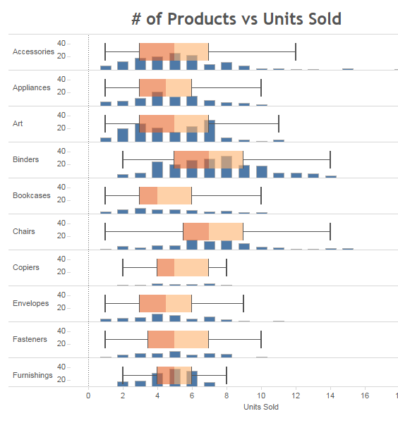
Distributions in Tableau
Histograms and box-and-whisker plot are good at showing distributions.
Histograms are great for 1 variable per chart.
Box-and-whisker can show several at once.
Each shows the same data, in slightly different ways.
The main reason we need to understand different distributions is to know if something is normal or not.

Slide 16
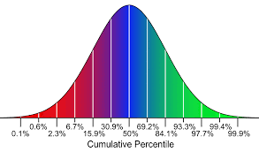
Percentiles
PERCENTILES indicate how far “up the scale” a value is.
What percentage of records is this value greater than?
Works the same as the median, the median is the 50% percentile.
Also less impacted by outliers, like the median.
The median is the value a record needs to be greater than 50% of records.
Commonly used in rankings:
E.g. the top 5%-10% of GPA in some states is guaranteed entrance in state colleges.
There might be variation on curriculum/test difficulty from year to year, but the top 5% can be assumed to be similarly capable every year.

Slide 17
Percentiles in Tableau
Tableau can calculate our percentiles easily:
“What percentile is this value in?” – Table calculation -> percentile.
“What value do I need to be in this percentile” – Measure -> percentile -> choose cutoff.

Slide 18
Measures of Dispersion
Measures of dispersion give us an idea of how spread out our data is over its range.
Highly dispersed data has values more evenly distributed.
Non-dispersed data is more clustered (usually near the mean).
The main measure of dispersion is the STANDARD DEVIATION, which is made from the VARIANCE.
One of the other measures needed to define a normal distribution.
If we know the mean and standard deviation, we know what a normal distribution looks like.
In real life (beyond scope) – collect a sample, measure mean/std for the sample, create a normal distribution with that mean/std, use the new normal distribution to represent the population, that estimation process also gives us expected error in our generalization.

Slide 19
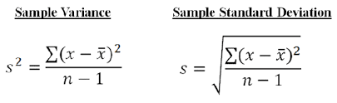
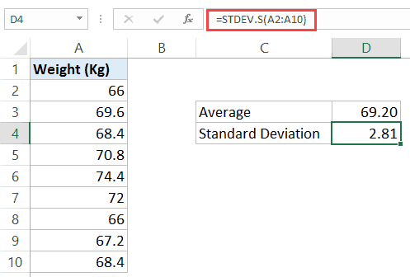
Standard Deviation and Variance
Variance is the average of the squared distances of values from the mean.
The squaring negates less/greater than, and penalizes small “misses” less.
High variance data has values far from the mean, low variance indicates they are closer.
Standard deviation is the square root of the variance.
We normally use the standard deviation.
On the same scale as the original data, while variance is a large number.
~ How far we expect the average value to be from the mean.

Slide 20
Dispersion in Tableau
Dispersion can be seen in a histogram, box-and-whisker plot, or others.
Dispersion can be measured with the standard deviation or variance functions.
We normally use the standard deviation.

Slide 21
Housekeeping
Stats – finish chapter 3.
Review basic stats – location, dispersion, distribution, range.
This will be the cutoff for the first test, which is a week from Wed.
Tableau: Parameters
“madden_23…” dataset.
Taking input from users.
Dynamic charts.
Comparing distributions (group and compare)
Tableau Quiz practice rounds – we’ll look at some solutions for the 1st next time, bring Q’s.

Slide 22
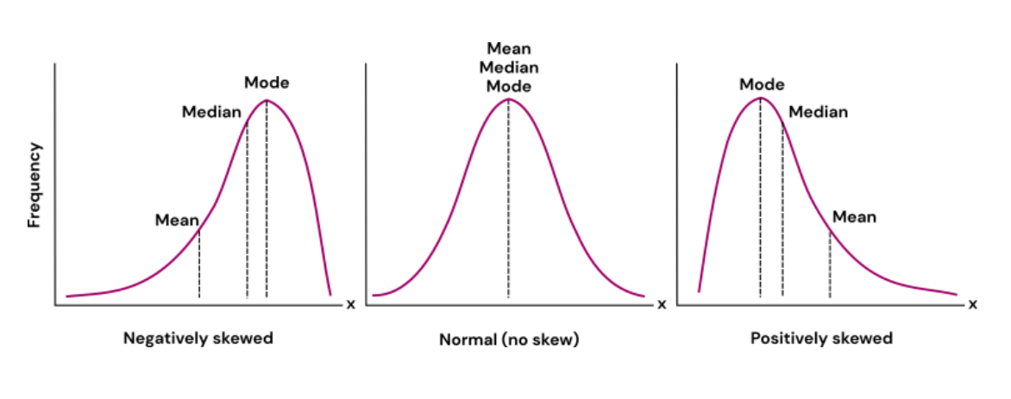
Location and Range

Slide 23
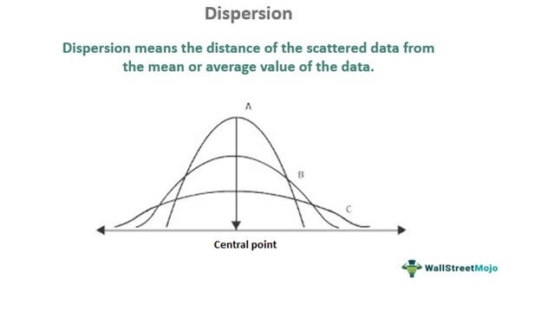
Dispersion

Slide 24
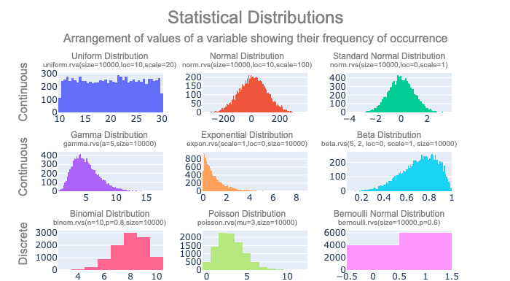
Distributions

Slide 25
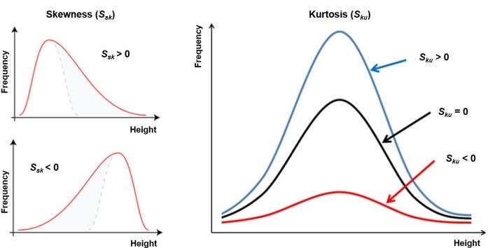
Skewness and Kurtosis
SKEWNESS indicates if a distribution is skewed, or shifted, in one direction or another.
Skew tells us if the distribution is “stretched” in one direction or the other.
+/- refers to the part “stretched” on a graph.
KURTOSIS is an indication of the “concentration” of the data around the mean.
Can also be thought of as “steepness”.
High kurtosis means most values are tightly clustered around the mean.

Slide 26
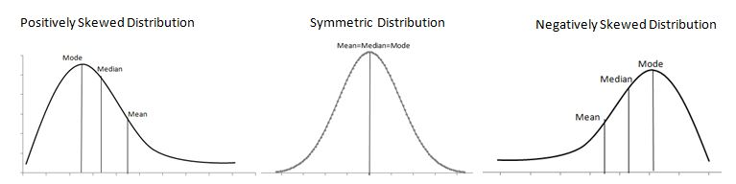
Skew and Kurtosis in Tableau
Skew and kurtosis are things that we largely detect by eye.
There are calculations, but they are well beyond our scope.
A histogram is the easiest way to see the skew and kurtosis.
We need to be attentive to the bin size.
These two are descriptors that we can use to talk about data, we won’t use them in any calculations.

Slide 27
Outliers
OUTLIERS are values that are too high or too low, that we may want to remove.
Outliers are things that can throw off our analysis.
E.g. if we are predicting if someone will repay a loan, and one value is “net worth”, having Bill Gates be part of the dataset probably doesn’t help us – he’s so rich he has nothing to do with “regular” folks.
Removing outliers always depends on DOMAIN KNOWLEDGE – knowing about the actual topic of the data.
Keeping or removing outliers depends on what we are doing.
For us, we probably want to remove things that are clearly outside of the pattern.

Slide 28
Variable Scaling
This is a bit of a side note, relating more to other analysis, but we should be aware.
One common technique in data analysis is to RESCALE data.
Take data from its original range, and remap it to a new range.
Normalization – map data to a range between 0 and 1.
Standardization – map data so the mean is 0, and the std is 1.
This can often make data easier (or better suited) to analyze.
E.g. when making predictions, values that are large (e.g. net worth) may “overpower” values that are small (e.g. age). Rescaling all variables eliminates that.

Slide 29
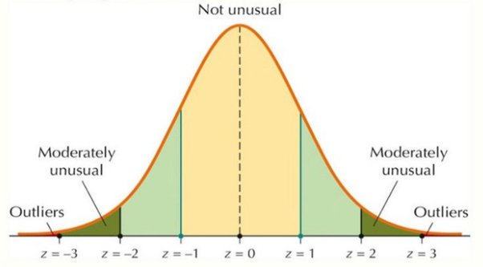
Normal Data Outlier Filters
One common way to find outliers is to filter by z-score, or standard deviations from the mean.
We can set a limit of X standard deviations for acceptable values.
3 is a common limit, ~.02% of data.
Limit is highly scenario dependent.
This can be automated, if processing large amounts of data.

Slide 30
Outliers in Tableau
Outliers in Tableau can be detected in many ways, histograms and box-and-whisker plots among them.
Outliers can be removed with a filter.
Can use “apply to” to share an outlier filter over many sheets.
What to do with outliers, and what qualifies as an outlier, is always a judgment call.

Slide 31
Relationships in Data
All the previous looks at data are describing one variable at a time.
We can also look at the relationships between variables.
Think about height vs. weight, those two things have some relationship to each other.
One variable can also inform our expectations on another variable.
Basis of some predictive analytics.

Slide 32
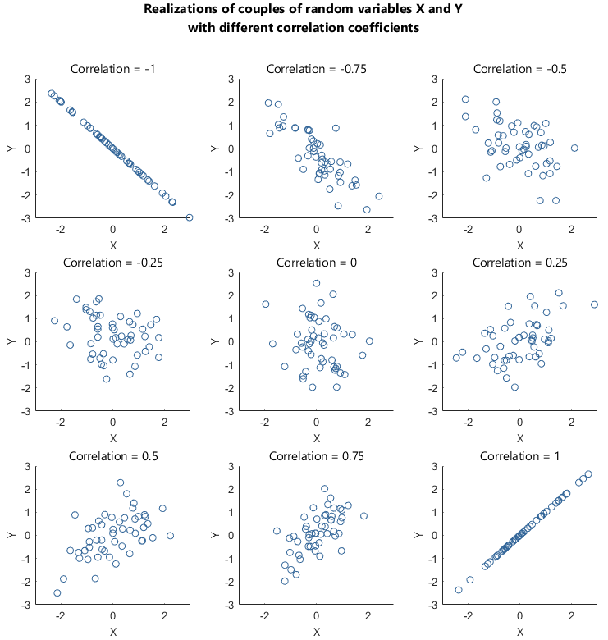
Correlation
The main way we can examine the relationship between variables is by looking at their CORRELATION.
Correlation tells us ”how much X tells us about Y”.
Correlation is between -1 and 1, the farther from 1, the stronger the correlation.
Unit/scale independent.
R2, a measure commonly used in predictive analytics, is the correlation squared.
Range of 0 to 1, higher is more correlated.
“How much of Y is explained by X?”

Slide 33
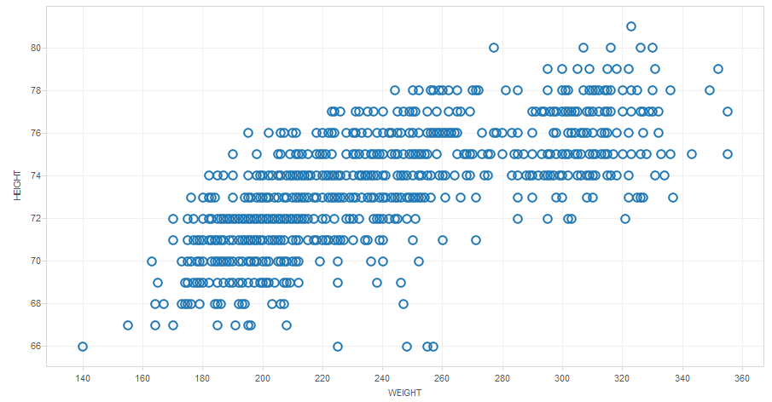
Correlation in Tableau
The easiest way to look at correlation is a scatter plot.
One variable on each axis, one point per record.
Trend lines will give us R2.
The “tightness” of the points inform us about the correlation.
Extends to linear regression (best fit) and predictive analytics – using X to predict Y.

Slide 34
Conclusion
Understanding what our data looks like, and how to describe it, helps substantially in using data, especially when sharing with others.
Knowing things like distributions can also give us a tool set of things we can use on our data.
Statistical patterns in the data are the building blocks of making predictions from the data.
These statistical descriptions aren’t things that we constantly need to “use”, but they are important.
When making projections, knowing distributions is key.
When preparing data for other analysis, the other measures can help us.
Communicating with others about data is easier with shared language.
Tl;dr this stuff matters and is useful, but it isn’t always obvious why/where – it expands the toolkit.

